Slide 1
Advanced System Software
Introduction
Slide #<number>

Slide 2
What is an OS kernel?
Program that is always running.
  Manages resources.
  Provides services.
Layering
  Layer between programs and hardware.
  Layer between users (multiuser OS).
  Layer between programs (multitasking OS).
Slide #<number>

Slide 3

What is an OS kernel?
Slide #<number>

Slide 4
Resource Management
Allocation
  Allocates finite resources among competing processes.
  CPU, memory, disk, network
Protection
  Prevents processes from interfering with each other.
Reclamation
  Voluntary at runtime; automatic at termination.
Virtualization
  Provides illusion of private unshared resources
  Timeshared CPU, Virtual Memory, Virtual Machines
Slide #<number>

Slide 5

What is the Linux kernel?
Linux is a member of the large family of Unix-like operating systems.
Free open source UNIX-compatible kernel.
  Created by Linus Torvalds.
  Developed by thousands across the world.
  Coordinated via linux-kernel mailing list.
Slide #<number>

Slide 6
Kernel History
0.01 First version released by Linus (1991).
1.0 First release (x86 only) in 1994.
1.2 Supports other CPUs (Alpha, MIPS) in 1995.
2.0 SMP support, more architectures (1996).
2.2 Efficient SMP, more hardware support (1999).
2.4 LVM, Plug-n-Play, USB, etc. (2001).
2.6 Scalability (embedded, NUMA, PAE, sched), kernel pre-emption, User-mode linux (2003).
Slide #<number>

Slide 7
Version Numbering: A.B.C.D
A: Major version
  Changed twice: 1.0 (1994), 2.0 (1996)
B: Minor version
  Even numbers are stable releases
  Odd numbers are development releases
C: Minor revision
  Not so minor in 2.6 as development continues.
D: Bug-fix / security patch release
  First occurred with NFS bug in 2.6.8.1
  Official policy as of 2.6.11
Slide #<number>

Slide 8
Kernel Versions
mm: Andrew Morton tree
  New patches, almost ready for distribution.
ac: Alan Cox tree
Distribution trees
  RedHat
  Mandrake
  Debian
  Gentoo, etc.
Slide #<number>

Slide 9
Linux is a true Unix kernel, although it is not a full Unix operating system, because it does not include all the applications such as filesystem utilities, windowing systems and graphical desktops, system administrator commands, text editors, compilers, and so on.
Slide #<number>

Slide 10
Assessment of Linux Vs Commercial Unix Kernels
Linux kernel is monolithic.
Traditional Unix kernels are compiled and linked statically.
Kernel threading.
Multithreaded application support.
Linux is a nonpreemptive kernel.
Multipurpose support
File Systems
STREAMS
Slide #<number>

Slide 11
Advantages of Linux
Linux is fully customizable in all its components.
Linux runs on low-end, cheap hardware platforms.
Linux is powerful.
Linux has a high standard for source code quality.
The Linux kernel can be very small and compact.
Linux is highly compatible with many common operating systems.
Linux is well supported.
Slide #<number>

Slide 12
Hardware Dependency
Linux tries to maintain a neat distinction between hardware-dependent and hardware independent source code.
  arm - Acorn personal computers
  i386- IBM-compatible personal computers based on Intel 80x86 or Intel 80x86-compatible microprocessors.
  sparc - Workstations based on Sun Microsystems SPARC microprocessors.
  m68k - Personal computers based on Motorola MC680x0 microprocessors
Slide #<number>

Slide 13
Multiusers Systems
A multiuser system is a computer that is able to concurrently and independently execute several applications belonging to two or more users.
Multiuser operating systems must include several features:
An authentication mechanism for verifying the user identity.
A protection mechanism against buggy user programs that could block other applications running in the system.
A protection mechanism against malicious user programs that could interfere with, or spy on, the activity of other users.
An accounting mechanism that limits the amount of resource units assigned to each user.
In order to ensure safe protection mechanisms, operating systems must make use of the hardware protection associated with the CPU privileged mode. Otherwise, a user program would be able to directly access the system circuitry and overcome the imposed bounds.
Unix is a multiuser system that enforces the hardware protection of system resources.
Slide #<number>

Slide 14
Users and Groups
In a multiuser system, each user has a private space on the machine: typically, he owns some quota of the disk space to store files, receives private mail messages, and so on.
The operating system must ensure that the private portion of a user space is visible only to its owner.
All users are identified by a unique number called the User ID , or UID.
In order to selectively share material with other users, each user is a member of one or more groups, which are identified by a unique number called a Group ID , or GID. Each file is also associated with exactly one group.
Any Unix-like operating system has a special user called root, superuser, or supervisor. The system administrator must log in as root in order to handle user accounts, perform maintenance tasks like system backups and program upgrades, and so on.
Slide #<number>

Slide 15
Processes
All operating systems make use of one fundamental abstraction: the process .
A process can be defined either as "an instance of a program in execution," or as the "execution context" of a running program.
In traditional operating systems, a process executes a single sequence of instructions in an address space ; the address space is the set of memory addresses that the process is allowed to reference.
Modern operating systems allow processes with multiple execution flows,i.e., multiple sequences of instructions executed in the same address space.
Systems that allow concurrent active processes are said to be multiprogramming or multiprocessing.
Several processes can execute the same program concurrently, while the same process can execute several programs sequentially.
Slide #<number>

Slide 16
Identifying the Running Kernel
> uname
Linux
> uname -r
2.6.10
> cat /proc/version
Linux version 2.6.10(jw@csc660) (gcc version 3.3.5) #3 Sun Dec 25 10:22:50 EST 2005
Slide #<number>

Slide 17
Investigating the Running Kernel: /proc
###: directory for each running process
cpuinfo: processor information
devices: supported hardware
diskstats: disk performance statistics
meminfo: memory usage information
modules: linux kernel modules
net: directory of network information
partitions: linux disk partitions
swaps: swap files/partitions in use by kernel
self: link to ### directory for current process
Slide #<number>

Slide 18
Process information
> ls -alF /proc/self
dr-xr-xr-x 2 jw jw 0 2005-12-29 13:46 attr/
-r-------- 1 jw jw 0 2005-12-29 13:46 auxv
-r--r--r-- 1 jw jw 0 2005-12-29 13:46 cmdline
lrwxrwxrwx 1 jw jw 0 2005-12-29 13:46 cwd -> /proc/20041/
-r-------- 1 jw jw 0 2005-12-29 13:46 environ
lrwxrwxrwx 1 jw jw 0 2005-12-29 13:46 exe -> /bin/bash*
dr-x------ 2 jw jw 0 2005-12-29 13:46 fd/
-r--r--r-- 1 jw jw 0 2005-12-29 13:46 maps
-rw------- 1 jw jw 0 2005-12-29 13:46 mem
-r--r--r-- 1 jw jw 0 2005-12-29 13:46 mounts
lrwxrwxrwx 1 jw jw 0 2005-12-29 13:46 root -> //
-r--r--r-- 1 jw jw 0 2005-12-29 13:46 stat
-r--r--r-- 1 jw jw 0 2005-12-29 13:46 statm
-r--r--r-- 1 jw jw 0 2005-12-29 13:46 status
dr-xr-xr-x 3 jw jw 0 2005-12-29 13:46 task/
-r--r--r-- 1 jw jw 0 2005-12-29 13:46 wchan
Slide #<number>

Slide 19
Process information
> cd /proc/self
> cat cmdline ; echo
-bash
> cat environ | tr '\0' '\n' | head -8
ENV_SET=1
MANPATH=/usr/local/man:/usr/man:/usr/share/man
PATH=/usr/ucb:/usr/bin:/bin:/sbin:/usr/sbin:/usr/local/bin
TERM=xterm
SHELL=/bin/bash
EDITOR=vim
VISUAL=vim
PAGER=less
> ls -l fd
total 4
lrwx------ 1 jw jw 64 2005-12-29 13:50 0 -> /dev/pts/3
lrwx------ 1 jw jw 64 2005-12-29 13:50 1 -> /dev/pts/3
lrwx------ 1 jw jw 64 2005-12-29 13:50 2 -> /dev/pts/3
Slide #<number>

Slide 20
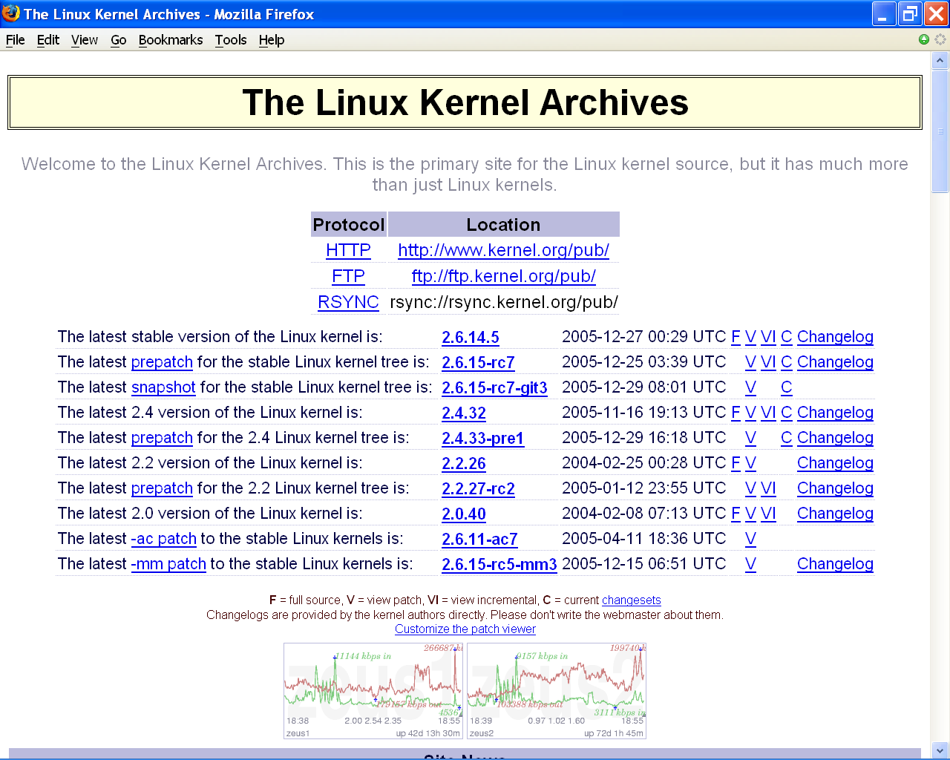
Obtaining the Kernel
Slide #<number>

Slide 21
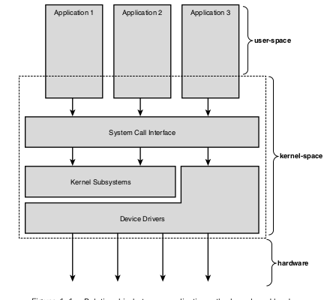
Kernel Architecture
Slide #<number>

Slide 22
Each kernel layer is integrated into the whole kernel program and runs in Kernel Mode on behalf of the current process.
Microkernel operating systems demand a very small set of functions from the kernel, generally including a few interrupt handlers, sevice interrupts requests, synchronization primitives, a simple scheduler, a memory management and an interprocess communication mechanism.
Several system processes that run on top of the microkernel implement other operating system-layer functions, like memory allocators, device drivers, system call handlers, and so on.
Microkernels force the system programmers to adopt a modularized approach, since any operating system layer is a relatively independent program that must interact with the other layers through well-defined and clean software interfaces.
Slide #<number>

Slide 23
An existing microkernel operating system can be fairly easily ported to other architectures, since all hardware- dependent components are generally encapsulated in the microkernel code.
Finally, microkernel operating systems tend to make better use of random access memory (RAM) than monolithic ones, since system processes that aren't implementing needed functionalities might be swapped out or destroyed.
Modules are kernel features that has advantage of microkernels without introducing performance penalties.
A module is an object file whose code can be linked to (and unlinked from) the kernel at runtime.
The object code usually consists of a set of functions that implements a filesystem, a device driver, or other features at the kernel's upper layer.
Slide #<number>

Slide 24
The module, unlike the external layers of microkernel operating systems, does not run as a specific process. Instead, it is executed in Kernel Mode on behalf of the current process, like any other statically linked kernel function.
The main advantages of using modules include -
Modularized approach
Platform independence
Frugal main memory usage
No performance penalty
Slide #<number>

Slide 25
Prepatches and Snapshots
Prepatches
  Alpha versions of the kernel, located in the testing/ subdirectory of kernel.org.
Snapshots
  Automatically created images of the kernel development tree. May not work or compile.
Slide #<number>

Slide 26
Obtaining the Kernel
Select the kernel version you need
2.6.10 for our course
Download the kernel
  wget ftp://ftp.kernel.org/pub/linux/kernel/v2.6/linux-2.6.10.tar.bz2
Unpack the kernel
  tar –xjf linux-2.6.10.tar.bz2
Slide #<number>

Slide 27
Overview of a Linux File system
As in Unix file system, Linux file is an information container structured as a sequence of bytes; the kernel does not interpret the contents of a file.
Many programming libraries implement higher-level abstractions, such as records structured into fields and record addressing based on keys.
However, the programs in these libraries must rely on system calls offered by the kernel.
From the user's point of view, files are organized in a tree-structured.
Slide #<number>

Slide 28
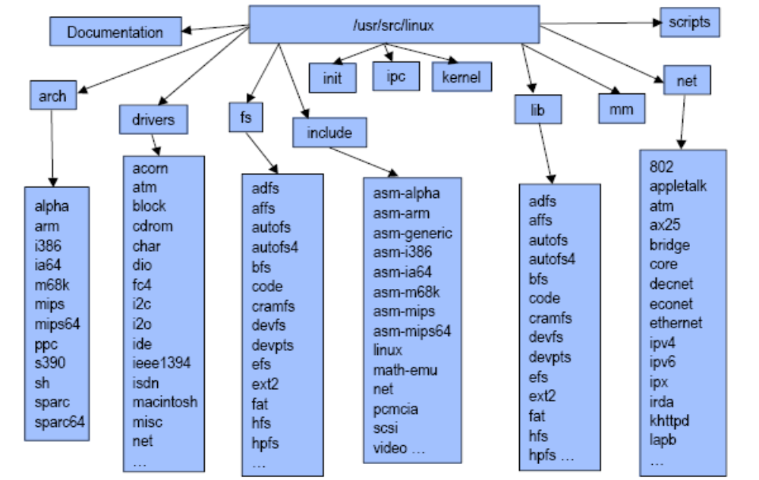
Linux Source Layout
Slide #<number>

Slide 29
Documentation
Text files documenting various aspects of kernel
  Can be very useful.
  Not well organized.
  Not always up to date.
Slide #<number>

Slide 30
arch
Architecture dependent code.
  Subdirectories for all current archs (22 in 2.6.10)
  i386 is subdirectory for x86 architecture
Contains architecture-dependent subdirs
  boot/
  kernel/
  lib/
  mm/
Slide #<number>

Slide 31
arch/i386
boot/ x86-specific boot code
crypto/ x86-optimized crypto functions
kernel/ x86-specific kernel core code
lib/ x86-optimized library code
mach-*/ x86 sub-architectures
math-emu/ FPU emulation code
oprofile/ kernel profiling tool
pci/ x86 PCI drivers
power/ x86 power management
Slide #<number>

Slide 32
drivers
Hardware device drivers.
Largest division of kernel code.
Major subdirectories
  char/
  block/
  net/
  scsi/
  buses (mca/, nubus/, pci/, sbus/)
Slide #<number>

Slide 33
fs
Virtual filesystem framework code.
Subdirectories for actual filesystems.
  ext2/
  ext3/
  hfs/
  isofs/
  nfs/
  ntfs/
  proc/
  ufs/
Slide #<number>

Slide 34
include
include/asm-*
  Architecture dependent subdirectories.
include/linux
  Headers needed by both kernel and user apps.
  User programs use /usr/include/linux
  Kernel parts guarded by
    #ifdef __KERNEL__
    …
    #endif
Slide #<number>

Slide 35
init
Kernel startup code
version.c: kernel version banner; prints at boot.
main.c: architecture independent boot code.
    See arch/i386/boot for arch-dependent code.
  start_kernel() is entry point.
Slide #<number>

Slide 36
ipc
System V UNIX IPC
Interprocess Communication Facilities
  sem.c semaphors
  shm.c shared memory
  msg.c messages
Slide #<number>

Slide 37
kernel
Core kernel code.
Scheduler
  sched.c
Process Control
  fork.c, exit.c, signal.c, wait.c
Kernel module support
  kmod.c, module.c
Other facilities
  dma.c, ptrace.c, softirq.c, spinlock.c, timer.c
Slide #<number>

Slide 38
lib
Kernel cannot call standard C library.
lib/ contains kernel’s own library routines
  Optimized libraries found under arch/i386/lib
Examples
  inflate.c Unpacks kernel at boot.
  rbtree.c Red-black tree implementation.
  string.c String-handling routines.
  vsprintf.c Replacement for libc vsprintf().
Slide #<number>

Slide 39
mm
Memory management
  memory.c Page table setup, page faults
  filemap.c File memory mapping
Allocation and Deallocation
  slab.c Slab allocator
  vmalloc. Kernel virtual memory allocator
Paging and Swapping
  vmscan.c Paging policies
  page_io.c Low level paging I/O
  swap.c Swapping
Slide #<number>

Slide 40
net
Low level networking protocols
  atm/, bluetooth/, decnet/ ethernet/
TCP/IP networking: ipv4/ and ipv6/
  ipv4/icmp.c ICMP
  ipv4/netfilter/*.c Netfilter firewall
  ipv4/route.c Routing code
  ipv4/tcp.c TCP
  ipv4/udp.c UDP
Slide #<number>

Slide 41
scripts
Kernel scripts for
  Building documentation
  Kernel configuration
Slide #<number>

Slide 42
Hard and Soft Links
A filename included in a directory is called a file hard link, or more simply a link. The same file may have several links included in the same directory or in different ones, thus several filenames.
The Unix command:
$ ln f1 f2
is used to create a new hard link that has the pathname f2 for a file identified by the pathname f1 .
Hard links have two limitations:
- Users are not allowed to create hard links for directories.
- Links can be created only among files included in the same filesystem.
In order to overcome these limitations, soft links (also called symbolic links) have been introduced.
Symbolic links are short files that contain an arbitrary pathname of another file.
The pathname may refer to any file located in any filesystem.
Slide #<number>

Slide 43
The Unix command:
$ ln -s f1 f2
creates a new soft link with pathname f2 that refers to pathname f1 .
Slide #<number>

Slide 44
File types
Unix files may have one of the following types:
Regular file
Directory
Symbolic link
Block-oriented device file
Character-oriented device file
Pipe and named pipe (also called FIFO)
Socket
Slide #<number>

Slide 45
File descriptor and Inode
There is a clear distinction between a file and file descriptor.
All information needed by the filesystem to handle a file is included in a data structure called an inode.
Each file has its own inode, which the filesystem uses to identify the file.
The filesystems and kernel functions handling them can vary from one system to another, but they must always provide atleast the following attributes:-
Slide #<number>

Slide 46
File type
Number of hard links associated with the file
File length in bytes
Device ID (i.e., an identifier of the device containing the file)
Inode number that identifies the file within the filesystem
User ID of the file owner
Group ID of the file
Several timestamps that specify the inode status change time, the last access time, and
the last modify time
Access rights and file mode
Slide #<number>

Slide 47
Access rights and File mode
The potential users of a file fall into three classes:
The user who is the owner of the file
The users who belong to the same group as the file, not including the owner
All remaining users (others)
Three types of access rights - Read, Write and Execute, for each of these three classes. The set of access rights associated with a file consists of nine different binary flags. Three additional flags include -
Slide #<number>

Slide 48
suid - A process executing a file normally keeps the User ID (UID) of the process owner. However, if the executable file has the suid flag set, the process gets the UID of the file owner.
sgid - A process executing a file keeps the Group ID (GID) of the process group. However, if the executable file has the sgid flag set, the process gets the ID of the file group.
sticky - An executable file with the sticky flag set corresponds to a request to the kernel to keep the program in memory after its execution terminates.
When a file is created by a process, its owner ID is the UID of the process.
Its owner group ID can be either the GID of the creator process or the GID of the parent directory, depending on the value of the sgid flag of the parent directory.
Slide #<number>

Slide 49
File Handling System Calls
Opening a file - Processes can access only "opened" files. In order to open a file, the process invokes the system call:
fd = open(path, flag, mode)
The three parameters have the following meanings:
path - Denotes the pathname (relative or absolute) of the file to be opened.
flag - Specifies how the file must be opened (e.g., read, write, read/write, append). It can also specify whether a nonexisting file should be created.
mode - Specifies the access rights of a newly created file.
Slide #<number>

Slide 50
This system call creates an "open file" object and returns an identifier called file descriptor .
An open file object contains:
Some file-handling data structures, like a pointer to the kernel buffer memory area where file data will be copied; an offset field that denotes the current position in the file from which the next operation will take place (the so-called file pointer); and so on.
Some pointers to kernel functions that the process is enabled to invoke. The set of permitted functions depends on the value of the flag parameter.
In order to create a new file, the process may also invoke the create( ) system call, which is handled by the kernel exactly like open( ) .
Slide #<number>

Slide 51
Accessing an opened file - The kernel stores the file pointer in the open file object, that is, the current position at which the next read or write operation will take place.
Sequential access is implicitly assumed: the read( ) and write( ) system calls always refer to the position of the current file pointer.
In order to modify the value, a program must explicitly invoke the lseek( ) system call. When a file is opened, the kernel sets the file pointer to the position of the first byte in the file (offset 0).
Slide #<number>

Slide 52
The lseek( ) system call requires the following parameters:
newoffset = lseek(fd, offset, whence);
which have the following meanings:
fd - Indicates the file descriptor of the opened file.
offset - Specifies a signed integer value that will be used for computing the new position of the file pointer.
whence - Specifies whether the new position should be computed by adding the offset value to the number (offset from the beginning of the file), the current file pointer, or the position of the last byte (offset from the end of the file).
Slide #<number>

Slide 53
The read( ) system call requires the following parameters:
nread = read(fd, buf, count);
which have the following meaning:
fd - Indicates the file descriptor of the opened file
buf - Specifies the address of the buffer in the process's address space to which the data will be transferred
count - Denotes the number of bytes to be read
Slide #<number>

Slide 54
Closing a file - When a process does not need to access the contents of a file anymore, it can invoke the system call:
res = close(fd);
which releases the open file object corresponding to the file descriptor fd
When a process terminates, the kernel closes all its still opened files.
Slide #<number>

Slide 55
Overview of Unix Kernel
Unix kernels provide an execution environment in which applications may run.
Therefore, the kernel must implement a set of services and corresponding interfaces.
Applications use those interfaces and do not usually interact directly with hardware resources.
Slide #<number>

Slide 56
Process/Kernel Mode
A CPU can run either in User Mode or in Kernel Mode.
Some CPUs can have more than two execution states.
Example - The Intel 80x86 microprocessors have four different execution states.
When a program is executed in User Mode, it cannot directly access the kernel data structures or the kernel programs.
When an application executes in Kernel Mode, however, these restrictions no longer apply.
Each CPU model provides special instructions to switch from User Mode to Kernel Mode and vice versa.
A program executes most of the time in User Mode and switches to Kernel Mode only when requesting a service provided by the kernel.
When the kernel has satisfied the program's request, it puts the program back in User Mode.
Slide #<number>

Slide 57
Processes are dynamic entities having a limited life span within the system. The task of creating, eliminating and synchronizing the existing processes is delegated to a group of routines in the kernel.
The kernel itself is not a process but a process manager.
The process/kernel model assumes that processes that require a kernel service make use of specific programming constructs called system calls.
Each system call sets up the group of parameters that identifies the process request and then executes the hardware-dependent CPU instruction to switch from User Mode to Kernel Mode.
Slide #<number>

Slide 58
Unix systems include a few privileged processes called kernel threads with the following characteristics:
  They run in Kernel Mode in the kernel address space.
  They do not interact with users, and thus do not require terminal devices.
  They are usually created during system startup and remain alive until the system is shut down.
The figure shows, Process 1 in User Mode issues a system call, after which the process switches to Kernel Mode and the system call is serviced.
Process 1 then resumes execution in User Mode until a timer interrupt occurs and the scheduler is activated in Kernel Mode.
A process switch takes place, and Process 2 starts its execution in User Mode until a hardware device raises an interrupt.
As a consequence of the interrupt, Process 2 switches to Kernel Mode and services the interrupt.
Slide #<number>

Slide 59
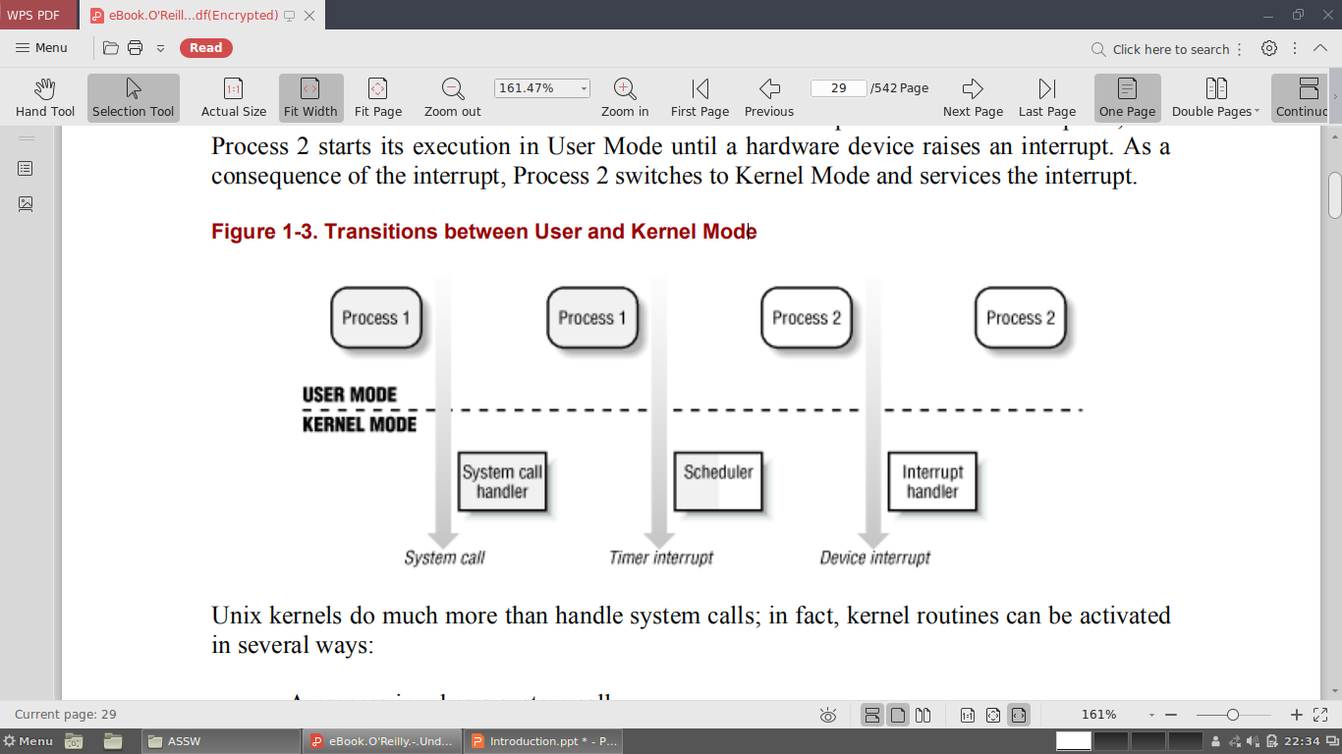
Transistions between User mode and Kernel mode
Slide #<number>

Slide 60
Unix kernels do much more than handle system calls -
  A process invokes a system call.
  The CPU executing the process signals an exception, which is some unusual condition such as an invalid instruction. The kernel handles the exception on behalf of the process that caused it.
  A peripheral device issues an interrupt signal to the CPU to notify it of an event such as a request for attention, a status change, or the completion of an I/O operation. Each interrupt signal is dealt by a kernel program called an interrupt handler. Since peripheral devices operate asynchronously with respect to the CPU, interrupts occur at unpredictable times.
  A kernel thread is executed; since it runs in Kernel Mode, the corresponding program must be considered part of the kernel, albeit encapsulated in a process.
Slide #<number>

Slide 61
Process Implementation
To let the kernel manage processes, each process is represented by a process descriptor that includes information about the current state of the process.
When the kernel stops the execution of a process, it saves the current contents of several processor registers in the process descriptor. These include:
  The program counter (PC) and stack pointer (SP) registers
  The general-purpose registers
  The floating point registers
  The processor control registers (Processor Status Word) containing information about the CPU state
  The memory management registers used to keep track of the RAM accessed by the process
Slide #<number>

Slide 62
When the kernel decides to resume executing a process, it uses the proper process descriptor fields to load the CPU registers.
Since the stored value of the program counter points to the instruction following the last instruction executed, the process resumes execution from where it was stopped.
When a process is not executing on the CPU, it is waiting for some event.
Slide #<number>

Slide 63
Reentrant Kernel
All Unix kernels are reentrant.
One way to provide reentrancy is to write functions so that they modify only local variables and do not alter global data structures. Such functions are called reentrant functions.
If a hardware interrupt occurs, a reentrant kernel is able to suspend the current running process even if that process is in Kernel Mode.
A kernel control path denotes the sequence of instructions executed by the kernel to handle a system call, an exception, or an interrupt.
The CPU executes a kernel control path sequentially from the first instruction to the last.
Slide #<number>

Slide 64
The following events occur when the CPU interleaves the kernel control paths:
  A process executing in User Mode invokes a system call and the corresponding kernel control path verifies that the request cannot be satisfied immediately; it then invokes the scheduler to select a new process to run. In this case, the two control paths are executed on behalf of two different processes.
  The CPU detects an exception.
  A hardware interrupt occurs while the CPU is running a kernel control path with the interrupts enabled.
Slide #<number>

Slide 65
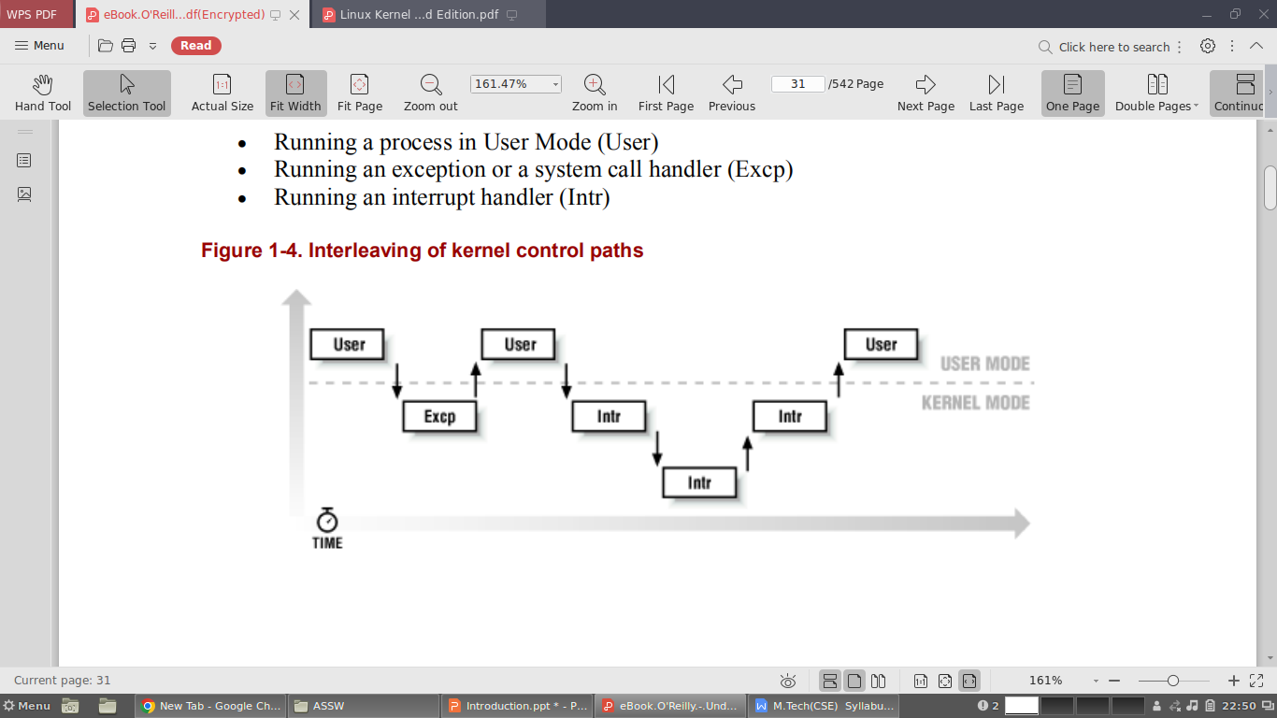
Slide #<number>

Slide 66
Process Address space
Each process runs in its private address space.
A process running in User Mode refers to private stack, data, and code areas.
When running in Kernel Mode, the process addresses the kernel data and code area and makes use of another stack.
There are times when part of the address space is shared among processes, i.e., explicitly requested by the processes or done automatically by the kernel to reduce memory usage.
Processes can also share parts of their address space as a kind of interprocess communication.
Slide #<number>

Slide 67
Synchronization and Critical Regions
Implementing a reentrant kernel requires the use of synchronization: if a kernel control path is suspended while acting on a kernel data structure, no other kernel control path will be allowed to act on the same data structure unless it has been reset to a consistent state.
When the outcome of some computation depends on how two or more processes are scheduled, the code is incorrect: there is a race condition.
Any section of code that should be finished by each process that begins it before another process can enter it is called a critical region.
These problems occur not only among kernel control paths but also among processes sharing common data.
Several synchronization techniques have been adopted.
The following types will concentrate on how to synchronize kernel control paths.
Slide #<number>

Slide 68
Non preemptive kernels - Nonpreemptability is ineffective in multiprocessor systems, since two kernel control paths running on different CPUs could concurrently access the same data structure.
Interrupt disabling - Another synchronization mechanism consists of disabling all hardware interrupts before entering a critical region and reenabling them right after leaving it.
Semaphores - A semaphore is simply a counter associated with a data structure; the semaphore is checked by all kernel threads before they try to access the data structure.
Spin locks - A spin lock is very similar to a semaphore, but it has no process list: when a process finds the lock closed by another process, it "spins" around repeatedly, executing a tight instruction loop until the lock becomes open.
Slide #<number>

Slide 69
Signals and Interprocess communication
Unix signals provide a mechanism for notifying processes of system events. Each event has its own signal number, which is usually referred to by a symbolic constant such as SIGTERM.
There are two kinds of system events:
  Asynchronous notifications - For instance, a user can send the interrupt signal SIGTERM to a foreground process by pressing the interrupt keycode (usually, CTRL-C) at the terminal.
  Synchronous errors or exceptions - For instance, the kernel sends the signal SIGSEGV to a process when it accesses a memory location at an illegal address.
Slide #<number>

Slide 70
In general, a process may react to a signal reception in two possible ways:
  Ignore the signal.
  Asynchronously execute a specified procedure (the signal handler).
If the process does not specify one of these alternatives, the kernel performs a default action that depends on the signal number. The five possible default actions are:
  Terminate the process.
  Write the execution context and the contents of the address space in a file (core dump) and terminate the process.
  Ignore the signal.
  Suspend the process.
  Resume the process's execution, if it was stopped.
Slide #<number>

Slide 71
Process management
The fork( ) and exit( ) system calls are used respectively to create a new process and to terminate it.
While an exec( )-like system call is invoked to load a new program.
The process that invokes a fork( ) is the parent while the new process is its child .
The exit( ) system call terminates a process.
The wait( ) system call allows a process to wait until one of its children terminates; it returns the process ID (PID) of the terminated child.
Slide #<number>

Slide 72
Kernel Reading
Online cross-referenced linux source tree
  http://lxr.linux.no/source/
Build your own cross-referenced source tree
  cd /usr/src/linux-2.6.10
  make tags
  vim –t tag
    Ctrl-] goto definition of tag under cursor
    Ctrl-t Return from goto tag
Slide #<number>

Slide 73
Quick Kernel Build
Configure
  make xconfig
Build
  make –j3 bzImage
Build modules
  make -j3 modules && make modules_install
Install
  cp arch/i386/boot/bzImage /boot/bzImage-VERSION
  cp System.map /boot/System.map-VERSION
  vim /boot/grub/menu.lst
Slide #<number>

Slide 74
Configuring the Kernel
kbuild: the kernel build system
Kernel configuration
  cp .config config.save Backup old config file.
  make mrproper Clean up from prior builds.
  vim .config Make configuration changes.
Interfaces
  make config Sequential questions on cli
  make menuconfig Ncurses-based menu interface
  make xconfig QT-based graphical interface
  make gconfig GTK-based graphical interface
Slide #<number>

Slide 75
.config
CONFIG_<NAME> options
y Include in kernel
n Don’t include in kernel
m Build as a kernel module (not for all items)
# Linux kernel version: 2.6.10
CONFIG_X86=y
CONFIG_MMU=y
CONFIG_UID16=y
CONFIG_GENERIC_ISA_DMA=y
CONFIG_GENERIC_IOMAP=y
# Code maturity level options
CONFIG_EXPERIMENTAL=y
CONFIG_CLEAN_COMPILE=y
CONFIG_BROKEN_ON_SMP=y
CONFIG_LOCK_KERNEL=y
# General setup
CONFIG_LOCALVERSION=""
Slide #<number>

Slide 76
Important Options
Code Maturity Level Options
  Experimental: Allow alpha-quality drivers.
  Clean compile: May not compile if set to “N”.
Loadable Module Support
Processor Type
  Use cat /proc/cpuinfo to determine.
Device Drivers
  Use lspci to see what current kernel supports.
  Networking configuration items located under here.
Filesystems
Kernel hacking
  Stuff for us: kernel debugging features.
Slide #<number>

Slide 77
Building the Kernel
Top kernel Makefile
  Reads configuration from .config.
  Updates include/linux/version.h
  Sets symlink include/asm to our architecture.
  Builds include/linux/autoconf.h
  Builds include/linux/config.h
  Invokes make –f scripts/Makefile.build obj=subdir for each subdirectory
Slide #<number>

Slide 78
Building the Kernel
In each subdirectory, Makefile.build reads the Makefile in that subdirectory.
Subdirectory Makefiles define
  obj-y Object files to build into kernel
  obj-m Object files to build into modules
Example from sched/Makefile
  obj-y = sched.o fork.o panic.o
  …
  obj-$(CONFIG_SMP) += cpu.o spinlock.o
  obj-$(CONFIG_UID16) += uid16.o
  obj-$(CONFIG_MODULES) += module.o
Slide #<number>

Slide 79
Installing the Kernel
Copy the kernel to /boot
  cp arch/i386/boot/bzImage /boot/bzImage-VERSION
Copy kernel symbols map to /boot
  cp System.map /boot/System.map-VERSION
Copy modules to /lib/modules/VERSION
  make modules_install
Modify the boot loader to boot new kernel.
  vim /boot/grub/menu.lst
Slide #<number>

Slide 80
Configuring the Bootloader
Bootloader is amall program residing on MBR.
  BIOS loads MBR and starts program.
  Bootloader copies rest of code from disk, then runs.
GRUB: GRand Unified Bootloader
  Configuration in /boot/grub/menu.lst
  Example GRUB stanza:
  title Ubuntu, kernel 2.6.10-5-386
  root (hd1,0)
  kernel /boot/vmlinuz-2.6.10-5-386 root=/dev/hde1 ro quiet splash
  initrd /boot/initrd.img-2.6.10-5-386
  savedefault
  boot
Slide #<number>

Slide 81
References
Daniel P. Bovet and Marco Cesati, Understanding the Linux Kernel, 3rd edition, O’Reilly, 2005.
Robert Love, Linux Kernel Development, 2nd edition, Prentice-Hall, 2005.
Kwan Lowe, Kernel Rebuild Guide, http://www.digitalhermit.com/linux/Kernel-Build-HOWTO.html, 2004.
LWN, “Another Look at the New Development Model,” http://lwn.net/Articles/94605/, 2004.
Joseph Pranovitch, Wonderful World of Linux 2.2, http://kniggit.net/wwol22.html, 1999.
Joseph Pranovitch, Wonderful World of Linux 2.4, http://kniggit.net/wwol24.html, 2001.
Joseph Pranovitch, Wonderful World of Linux 2.6, http://kniggit.net/wwol24.html, 2003.
Claudia Rodriguez et al, The Linux Kernel Primer, Prentice-Hall, 2005.
Andrew S. Tanenbaum, Modern Operating Systems, 2nd edition, Prentice-Hall, 2001.
Linus Torvalds and David Diamond, Just For Fun: The Story of an Accidental Revolutionary, Collins, 2001.
Slide #<number>

